Slide 1
Uva 1201
Taxi Cab Scheme
NWERC 2004, LA 3126
Time: 3 seconds

Slide 2
Problem Description (1/2)
Running a taxi station is not all that simple. Apart from the obvious demand for a centralised coordination of the cabs in order to pick up the customers calling to get a cab as soon as possible, there is also a need to schedule all the taxi rides which have been booked in advance.
Given a list of all booked taxi rides for the next day, you want to minimise the number of cabs needed to carry out all of the rides.

Slide 3
Problem Description (2/2)
For the sake of simplicity, we model a city as a rectangular grid. An address in the city is denoted by two integers: the street and avenue number. The time needed to get from the address (a, b) to (c, d) by taxi is |a-c|+ |b-d| minutes.
A cab may carry out a booked ride if it is its first ride of the day, or if it can get to the source address of the new ride from its latest, at least one minute before the new rides scheduled departure.
Note that some rides may end after midnight.

Slide 4
Input (1/2)
On the first line of the input is a single positive integer N, telling the number of test scenarios to follow.
Each scenario begins with a line containing an integer M, 0 < M < 500, being the number of booked taxi rides. The following M lines contain the rides.

Slide 5
Input (2/2)
Each ride is described by a departure time on the format hh : mm (ranging from 00:00 to 23:59), two integers a b that are the coordinates of the source address and two integers c d that are the coordinates of the destination address.
All coordinates are at least 0 and strictly smaller than 200.
The booked rides in each scenario are sorted in order of increasing departure time.

Slide 6
Output
For each scenario, output one line containing the minimum number of cabs required to carry out all the booked taxi rides.

Slide 7

Sample Input / Output
1 minites
Number of test cases
2
2
08:00 10 11 9 16
08:07 9 16 10 11
2
08:00 10 11 9 16
08:06 9 16 10 11
1
2
6 minites
Number of booked rides
6 minites
Destination
Source
Departure time
(0,0)

Slide 8
Sample Input / Output
Number of test cases
2
2
08:00 10 11 9 16
08:07 9 16 10 11
2
08:00 10 11 9 16
08:06 9 16 10 11
1
2
6 minites
Number of booked rides
6 minites
Destination
Source
Departure time
(0,0)

Slide 9
KM Algorithm

Slide 10
Perfect Bipartite Matching
找 Augmenting Path
增加 cardinality
cardinality
1
A
1
A
1
A
2
B
2
B
2
B
3
C
3
C
3
C
4
D
4
D
4
D
5
E
5
E
5
E

Slide 11
Perfect Bipartite Matching
4
D
3
A
1
B
4
D
3
A
1
B
1
A
1
A
1
A
2
B
2
B
2
B
3
C
3
C
3
C
4
D
4
D
4
D
5
E
5
E

Slide 12
Perfect Bipartite Matching
Perfect Matching
Not Perfect Matching
1
A
1
A
2
B
if
2
B
5

E
3
C
3
C
4
D
4
D
5
E
5
E
From Node 5,
we cannot find an Augmenting Path

Slide 13
Maximum Weight Perfect Bipartite Matching
5
1
A
3
-3
2
2
B
6
4
3
C
-2
3
4
D
6
5
E
1

Slide 14
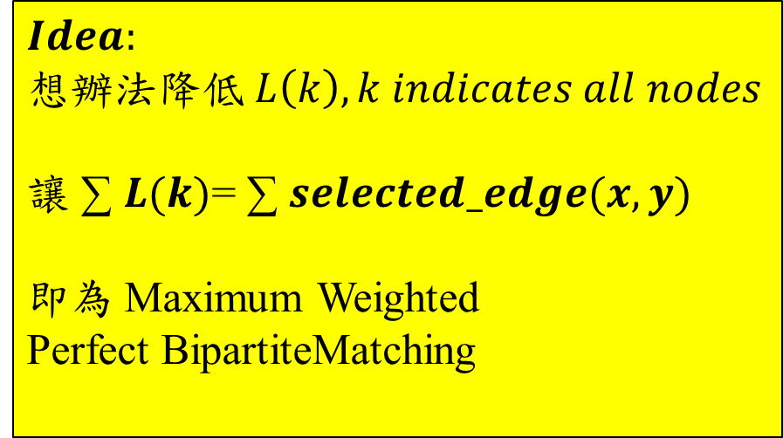
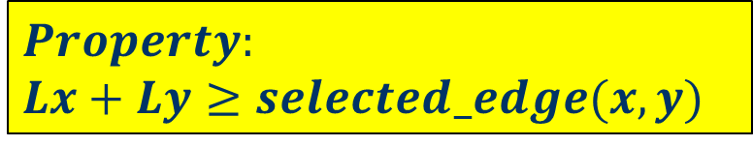
Equality Edge
Lx
Ly
label
label
5
5
5
0
5
1
A
0
1
A
3
-3
$$Property:$$
$$Lx+Ly≥selected_edge(x,y)$$
6
2
2
B
0
6
4
4
3
C
0
-2
$$Idea:$$
想辦法降低$L\left(k\right), k indicates all nodes$
讓 ∑ $L(k)$= ∑ $selected_edge(x,y)$
即為 Maximum Weighted
Perfect BipartiteMatching
3
3
4
D
0
6
6
5
E
0
1

Slide 15
Maximum Weight Perfect Bipartite Matching
label
label
label
label
5
5
5
1
A
5
1
A
0
5
1
A
0
3
3
3
-3
-3
-3
2
2
B
6
2
2
B
0
6
2
2
B
0
6
6
6
4
4
4
3
C
4
3
C
0
4
3
C
0
-2
-2
-2
3
3
3
4
D
3
4
D
0
3
4
D
0
6
6
6
5
E
6
5
E
0
6
5
E
0
1
1
1
X
Y
X
Y

Slide 16
Maximum Weight Perfect Bipartite Matching
5+6+4+3+6=24
label
5
label
原本
後來
差
5
1
A
0
3
-3
4
4
0
5
3
0
5
5+0-3=2
6
2
2
B
0
3
A
1
B
6
4
4
3
C
0
-2
3
3
4
D
0
6
6
5
E
0
1
X
Y

Slide 17
Maximum Weight Perfect Bipartite Matching
label
label
5
0
5
0
3
1
A
2
4
4
5
3
3
3
A
1
B
-3
6
2
2
B
0
6
4
2
3
C
0
-2
-2
+2
-2
odd
even
odd
3
2
2
3
0
3
4
D
0
4
5
3
3
A
1
B
6
6
5
E
0
1
X
Y

Slide 18
Maximum Weight Perfect Bipartite Matching
label
3+4+2+3+6+2+2=22
label
5
3
1
A
2
3
-3
6
2
2
B
0
6
4
2
3
C
0
-2
3
3
4
D
0
6
6
5
E
0
1
X
Y

Slide 19
Maximum Weight Perfect Bipartite Matching
label
label
5
6
0
3
1
A
2
3
3
0
6
2
6+0-2=4
3
4
D
2
C
-3
2
2
2
B
0
6
4
2
3
C
0
-4
+4
-4
-2
-1
4
2
0
3
6
2
-1
3
4
4
D
2
C
4
D
6
6
5
E
0
1
X
Y

Slide 20
Maximum Weight Perfect Bipartite Matching
label
3-2-1+6+6+6+2=20
label
5
3
1
A
2
3
-3
2
2
2
B
0
6
4
2
3
C
0
-2
3
-1
4
D
4
6
6
5
E
0
1
X
Y

Slide 21
Maximum Weight Perfect Bipartite Matching
label
label
6
0
5
1
6+0-1=5
3
1
A
2
5
E
3
-3
6
2
2
2
B
0
D
4
6
4
3
-1
4
-5
2
3
C
0
-2
1
0
1
5
E
3
-6
4
D
9
6
D
3
4
6
9
-6
1
5
E
0
+5
-5
1
X
Y

Slide 22
Maximum Weight Perfect Bipartite Matching
3+2+2-6+1+2+9=13
label
label
5
3
1
A
2
3
3+2+4+3+1=13
-3
2
2
2
B
0
Maximum Match
6
4
2
3
C
0
-2
3
-6
4
D
9
6
1
5
E
0
1
X
Y

Slide 23
Minimum Vertex Cover (1/5)
A vertex cover of an undirected graph is a subset of its vertices such that for every edge (u, v) of the graph, either ‘u’ or ‘v’ is in vertex cover.
Although the name is Vertex Cover, the set covers all edges of the given graph. Given an undirected graph, the vertex cover problem is to find minimum size vertex cover.

Slide 24
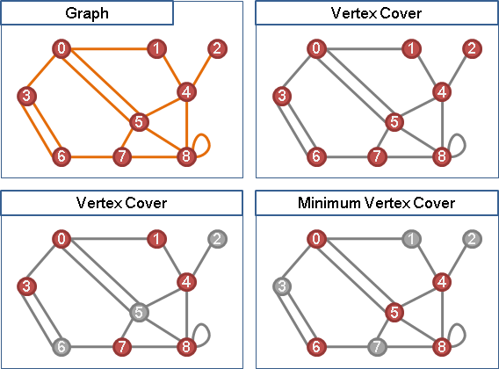
Minimum Vertex Cover (2/5)
5 vertexes

Slide 25
Minimum Vertex Cover (3/5)
Minimum Vertex Cover [NP-complete]
In Tree [P-問題]
Dynamic Programming
In Bipartite Graph [P-問題]
轉 Maximum Cardinality Bipartite Matching

Slide 26
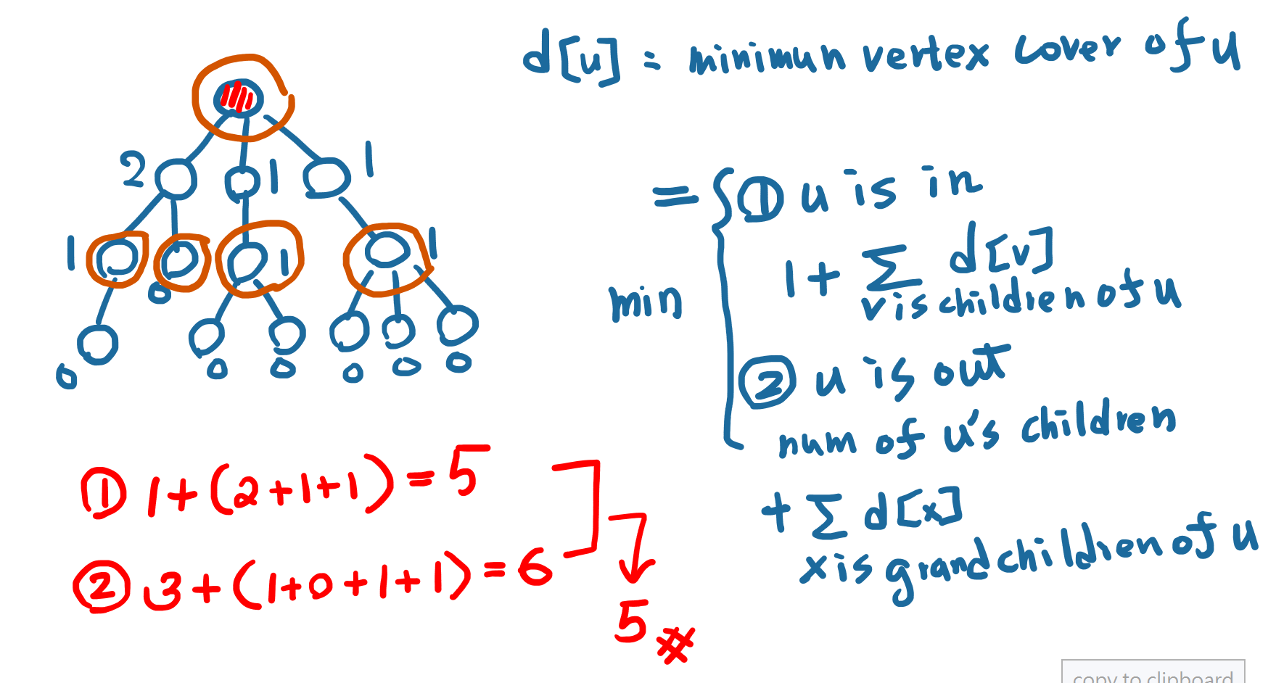
Minimum Vertex Cover in a tree(4/5)

Slide 27
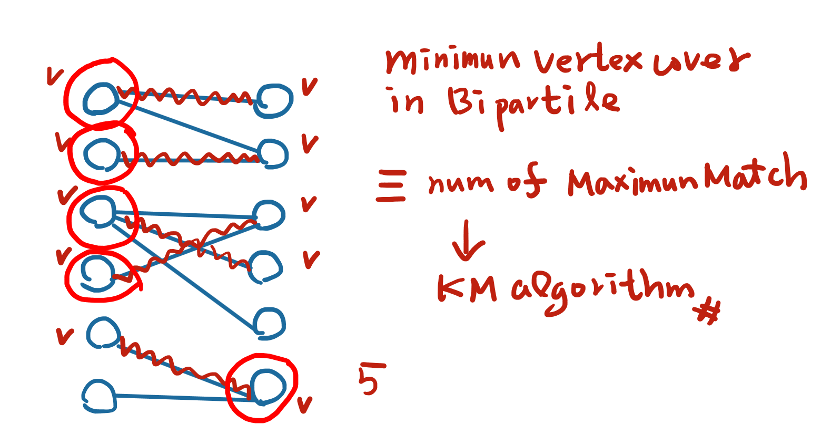
Minimum Vertex Cover in Bipartile (5/5)

Slide 28
Maximum Independent Set(1/5)
An independent set, stable set, coclique or anticlique is a set of vertices in a graph, no two of which are adjacent.
It is a set of vertices such that for every two vertices in the set, there is no edge connecting the two.
Equivalently, each edge in the graph has at most one endpoint in the set. The size of an independent set is the number of vertices it contains. Independent sets have also been called internally stable sets.

Slide 29
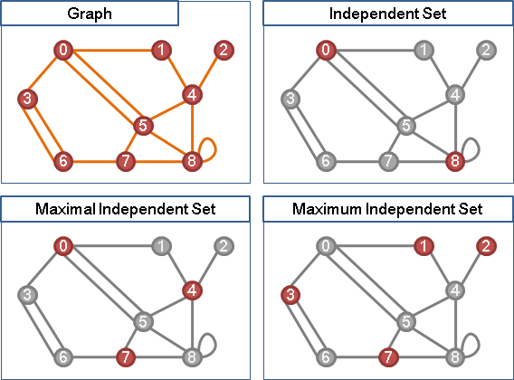
Independent Set (2/5)
4 vertexes

Slide 30
Maximum Independent Set(3/5)
Maximum Independent Set [NP-complete]
In Tree [P-問題]
Dynamic Programming
In Bipartite Graph [P-問題]
轉Maximum Cardinality Bipartite Matching

Slide 31
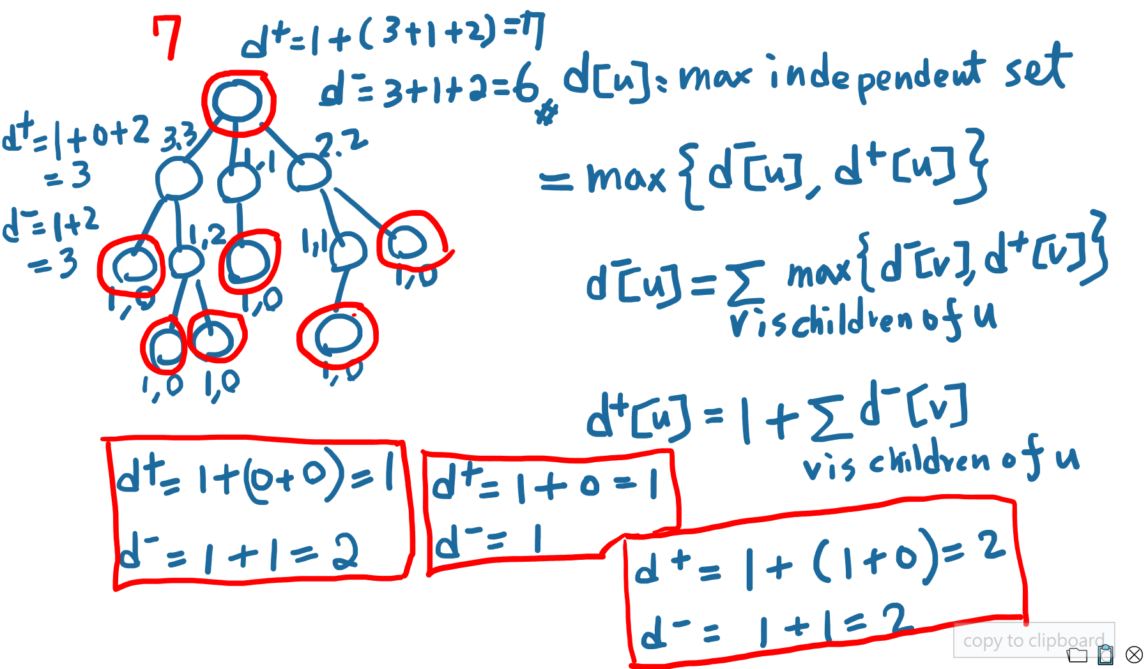
Minimum Independent Set in a tree(4/5)

Slide 32
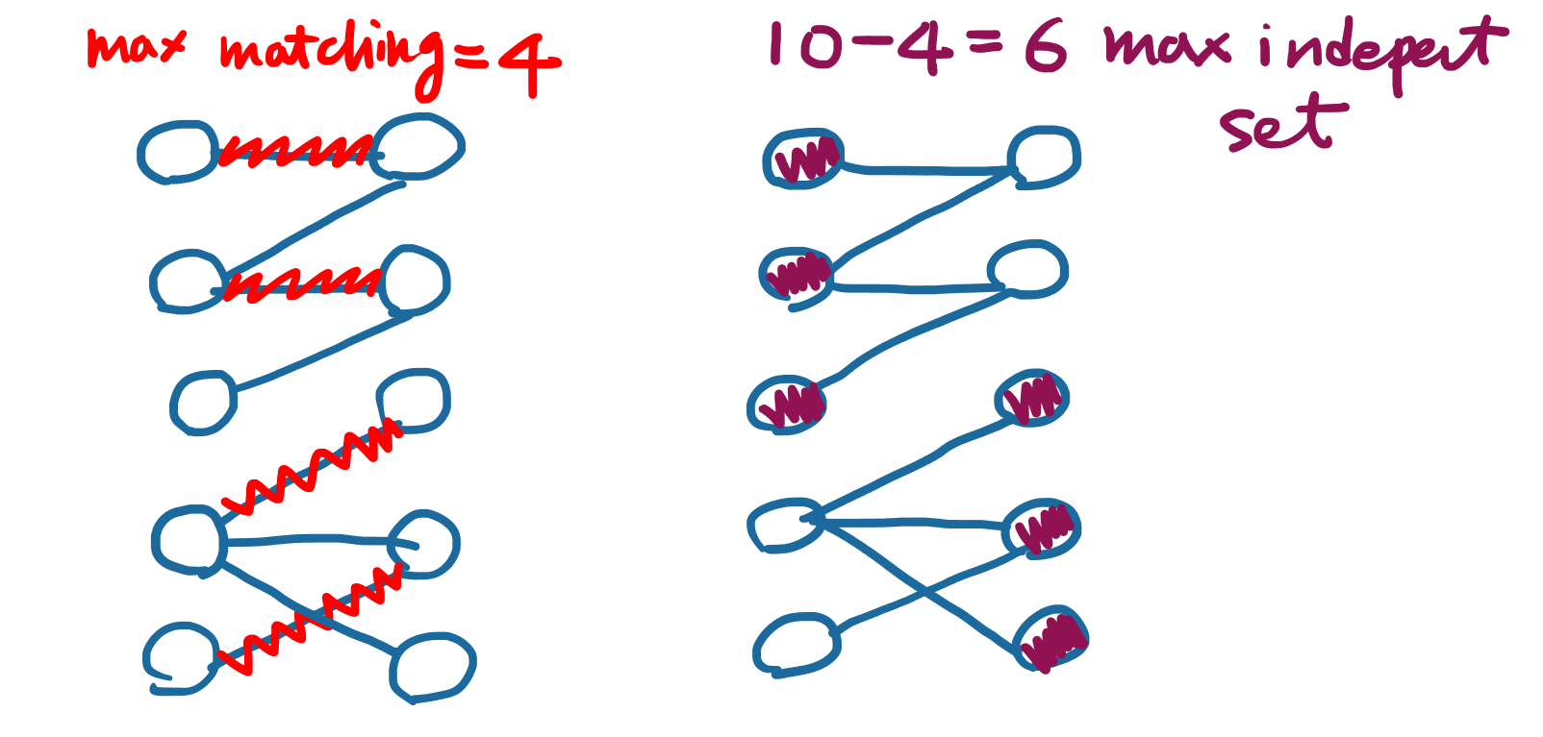
Maximum Independent Set in Bipartile (5/5)

Slide 33
Minimum Edge Cover (1/5)
In graph theory, an edge cover of a graph is a set of edges such that every vertex of the graph is incident to at least one edge of the set.
Minimum edge cover problem is the problem of finding an edge cover of minimum size.
It is an optimization problem that belongs to the class of covering problems and can be solved in polynomial time.

Slide 34
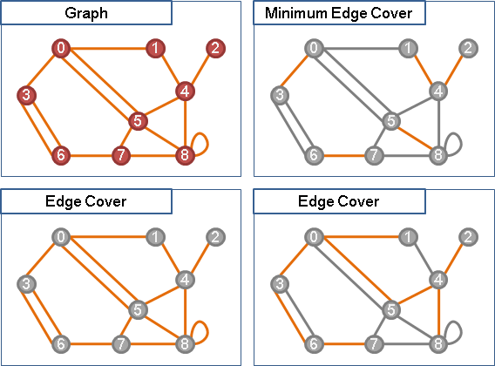
Minimum Edge Cover (2/5)
5 edges

Slide 35
Minimum Edge Cover (3/5)
Minimum Edge Cover [P-問題]
轉成 Maximum Matching
in Bipartite Graph [P-問題]
利用Greedy演算法，優先覆蓋degree最小的點
Minimum/Maximum Weight Edge Cover [P]
一張圖上權重最小（大）的Edge Cover
Minimum/Minimum Weight Matching

Slide 36
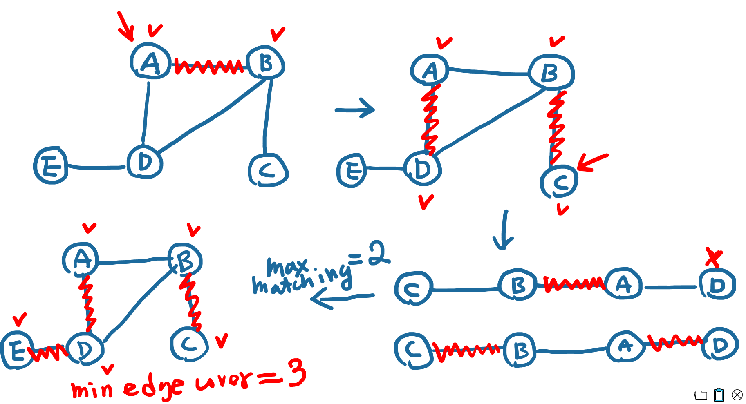
Minimum Edge Cover (4/5)
Minimum Edge Cover [P-問題]
Maximum Matching + 加入沒覆蓋到的點

Slide 37
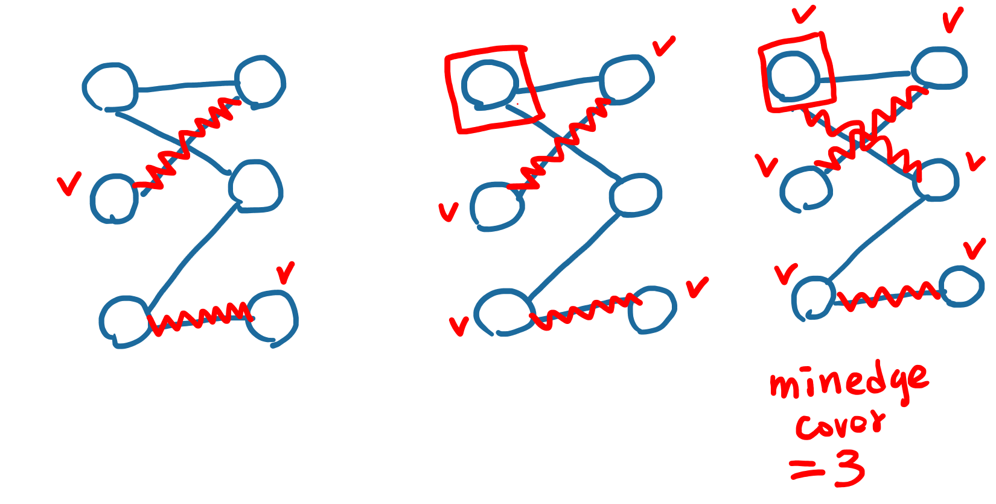
Minimum Edge Cover (5/5)
in Bipartite Graph [P-問題]
利用Greedy演算法，優先覆蓋degree最小的點

Slide 38
Minimum Path Cover in DAG
4個乘客
A
B
A
A
B
B
D
C
C
C
D
D

Slide 39
Minimum Path Cover in DAG
Max matching=3
4個乘客
A
A
A
A
B
B
B
B
C
C
C
C
D
D
D
D

Slide 40
Minimum Path Cover in DAG
Max matching=3
Ans=Minmum path Cover
=(Number of Customer
– max matching)
=4-3=1
A
A
B
B
A
B
C
C
D
C
D
D

Slide 41
Minimum Path Cover in DAG
4個乘客
A
B
A
A
B
B
D
C
C
C
D
D

Slide 42
Minimum Path Cover in DAG
Max matching=3
4個乘客
A
A
A
A
B
B
B
B
C
C
C
C
D
D
D
D

Slide 43
Minimum Path Cover in DAG
Max matching=2
Ans=Minmum path Cover
=(Number of Customer
– max matching)
=4-2=2
A
A
B
B
A
B
C
C
D
C
D
D

Slide 44
Minimum Path Cover in DAG
Max matching=2
Ans=Minmum path Cover
=(Number of Customer
– max matching)
=4-2=2
A
A
B
B
A
B
C
C
D
C
D
D

Slide 45
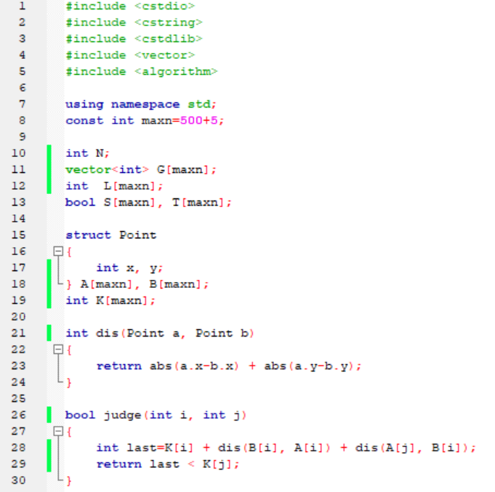

Slide 46
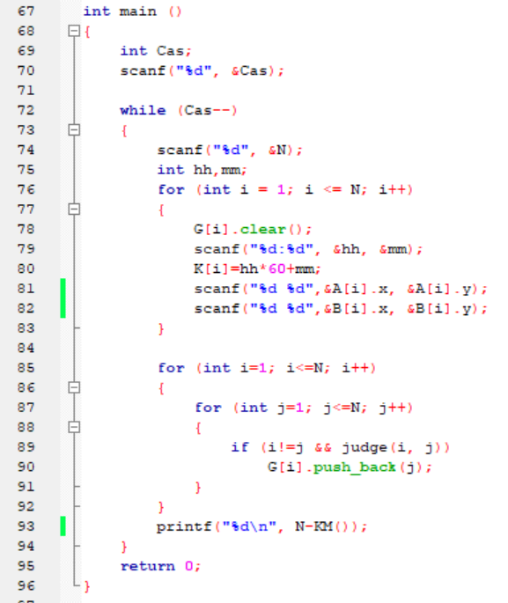

Slide 47
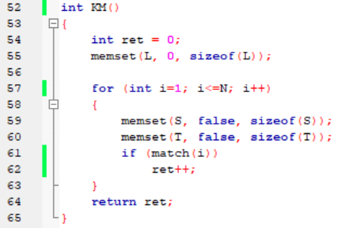
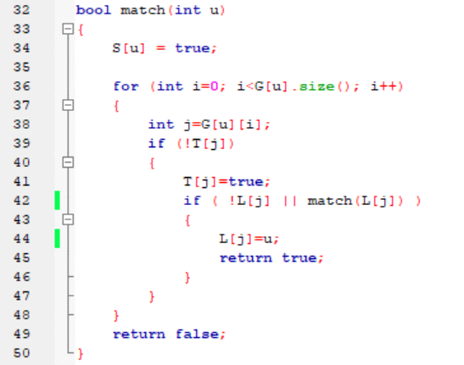

Slide 48
Golden Tiger Claw
Uva 11383
8 seconds

Slide 49
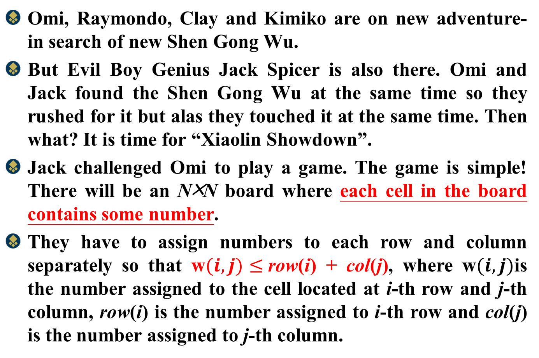
Problem Descriptions (1/2)
Omi, Raymondo, Clay and Kimiko are on new adventure- in search of new Shen Gong Wu.
But Evil Boy Genius Jack Spicer is also there. Omi and Jack found the Shen Gong Wu at the same time so they rushed for it but alas they touched it at the same time. Then what? It is time for “Xiaolin Showdown”.
Jack challenged Omi to play a game. The game is simple! There will be an N╳N board where each cell in the board contains some number.
They have to assign numbers to each row and column separately so that w$(i,j)≤$row(i) + col(j), where w$(i,j)$is the number assigned to the cell located at i-th row and j-th column, row(i) is the number assigned to i-th row and col(j) is the number assigned to j-th column.

Slide 50
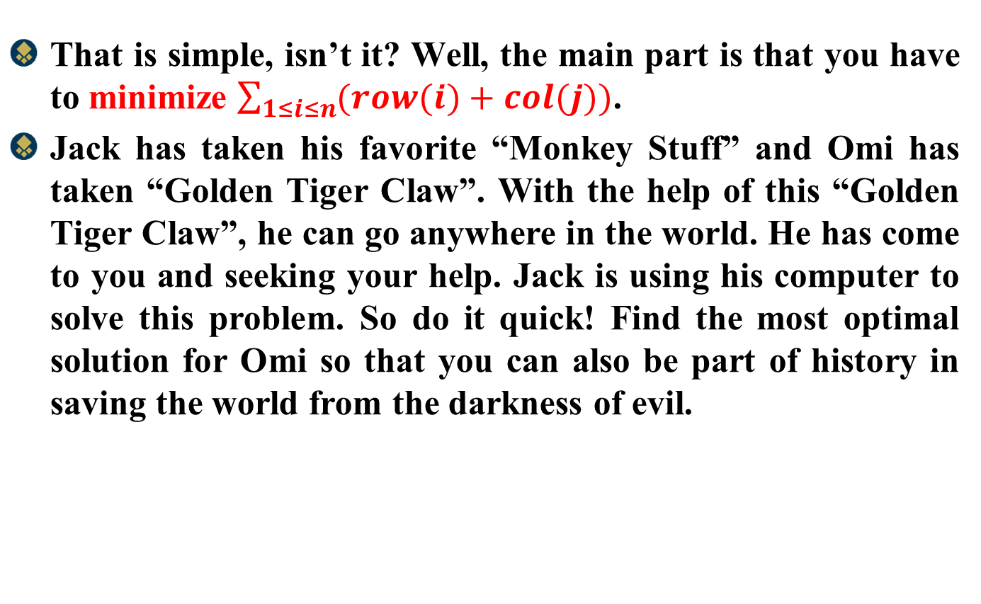
Problem Descriptions (2/2)
That is simple, isn’t it? Well, the main part is that you have to minimize $\sum_{1≤i≤n}{(row(i)+col(j)})$.
Jack has taken his favorite “Monkey Stuff” and Omi has taken “Golden Tiger Claw”. With the help of this “Golden Tiger Claw”, he can go anywhere in the world. He has come to you and seeking your help. Jack is using his computer to solve this problem. So do it quick! Find the most optimal solution for Omi so that you can also be part of history in saving the world from the darkness of evil.

Slide 51
Input
Input contains 15 test cases.
Each case starts with N.
Then there are N lines containing N numbers each. All the numbers in input is positive integer within the limit 100 except N which can be at most 500.

Slide 52
Output
For each case, print minimum sum in a line.

Slide 53
Example
N
2
1 1
1 1
2
row
column
1
1
0
1 | 1
1 | 1
0

Slide 54








Solution Bipartite Graph
row
column
1
1
0
1 | 1
1 | 1
0
column
row
$$Lx1+ly2≥1$$
1
$$Ly1$$
$$Lx1+ly1≥1$$
$$Lx1$$
1
1
1
1
$$Lx2+ly1≥1$$
$$Lx2$$
$$Ly2$$
$$Lx1+ly2≥1$$
2
1
2

Slide 55
KM Algorithm

Slide 56
Perfect Bipartite Matching
找 Argument Path
增加 cardinality
cardinality
1
A
1
A
1
A
2
B
2
B
2
B
3
C
3
C
3
C
4
D
4
D
4
D
5
E
5
E
5
E

Slide 57
Perfect Bipartite Matching
4
D
3
A
1
B
4
D
3
A
1
B
1
A
1
A
1
A
2
B
2
B
2
B
3
C
3
C
3
C
4
D
4
D
4
D
5
E
5
E

Slide 58
Perfect Bipartite Matching
Perfect Matching
Not Perfect Matching
1
A
1
A
2
B
if
2
B
5

E
3
C
3
C
4
D
4
D
5
E
5
E
From Node 5,
we cannot find an Argument Path

Slide 59
Maximum Weight Perfect Bipartite Matching
5
1
A
3
-3
2
2
B
6
4
3
C
-2
3
4
D
6
5
E
1

Slide 60
Equality Edge
Lx
Ly
label
label
5
5
5
0
5
1
A
0
1
A
3
-3
$$Property:$$
$$Lx+Ly≥selected_edge(x,y)$$
6
2
2
B
0
6
4
4
3
C
0
-2
$$Idea:$$
想辦法降低$L\left(k\right), k indicates all nodes$
讓 ∑ $L(k)$= ∑ $selected_edge(x,y)$
即為 Maximum Weighted
Perfect BipartiteMatching
3
3
4
D
0
6
6
5
E
0
1

Slide 61
Maximum Weight Perfect Bipartite Matching
label
label
label
label
5
5
5
1
A
5
1
A
0
5
1
A
0
3
3
3
-3
-3
-3
2
2
B
6
2
2
B
0
6
2
2
B
0
6
6
6
4
4
4
3
C
4
3
C
0
4
3
C
0
-2
-2
-2
3
3
3
4
D
3
4
D
0
3
4
D
0
6
6
6
5
E
6
5
E
0
6
5
E
0
1
1
1
X
Y
X
Y

Slide 62
Maximum Weight Perfect Bipartite Matching
5+6+4+3+6=24
label
5
label
原本
後來
差
5
1
A
0
3
-3
4
4
0
5
3
0
5
5+0-3=2
6
2
2
B
0
3
A
1
B
6
4
4
3
C
0
-2
3
3
4
D
0
6
6
5
E
0
1
X
Y

Slide 63
Maximum Weight Perfect Bipartite Matching
label
label
5
0
5
0
3
1
A
2
4
4
5
3
3
3
A
1
B
-3
6
2
2
B
0
6
4
2
3
C
0
-2
-2
+2
-2
odd
even
odd
3
2
2
3
0
3
4
D
0
4
5
3
3
A
1
B
6
6
5
E
0
1
X
Y

Slide 64
Maximum Weight Perfect Bipartite Matching
label
3+4+2+3+6+2+2=22
label
5
3
1
A
2
3
-3
6
2
2
B
0
6
4
2
3
C
0
-2
3
3
4
D
0
6
6
5
E
0
1
X
Y

Slide 65
Maximum Weight Perfect Bipartite Matching
label
label
5
6
0
3
1
A
2
3
3
0
6
2
6+0-2=4
3
4
D
2
C
-3
2
2
2
B
0
6
4
2
3
C
0
-4
+4
-4
-2
-1
4
2
0
3
6
2
-1
3
4
4
D
2
C
4
D
6
6
5
E
0
1
X
Y

Slide 66
Maximum Weight Perfect Bipartite Matching
label
3-2-1+6+6+6+2=20
label
5
3
1
A
2
3
-3
2
2
2
B
0
6
4
2
3
C
0
-2
3
-1
4
D
4
6
6
5
E
0
1
X
Y

Slide 67
Maximum Weight Perfect Bipartite Matching
label
label
6
0
5
1
6+0-1=5
3
1
A
2
5
E
3
-3
6
2
2
2
B
0
D
4
6
4
3
-1
4
-5
2
3
C
0
-2
1
0
1
5
E
3
-6
4
D
9
6
D
3
4
6
9
-6
1
5
E
0
+5
-5
1
X
Y

Slide 68
Maximum Weight Perfect Bipartite Matching
3+2+2-6+1+2+9=13
label
label
5
3
1
A
2
3
3+2+4+3+1=13
-3
2
2
2
B
0
Maximum Match
6
4
2
3
C
0
-2
3
-6
4
D
9
6
1
5
E
0
1
X
Y

Slide 69
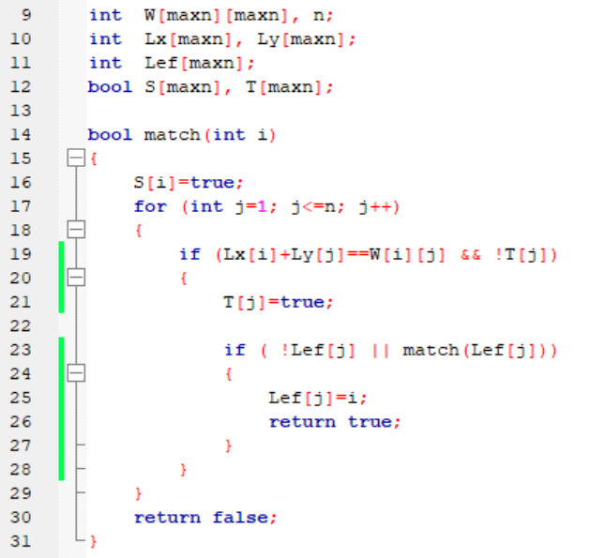
Kuhn-Munkres (KM) Algorithm
label
label
S
Lx
Ly
T
1
Lef

Slide 70
S
Lx
Ly
T
label
label
5
5
╳
5
6
4
3
6
0
0
0
0
0
╳
1
A
5
1
A
0
3
3
-3
-3
2
2
B
6
2
2
B
0
6
6
4
4
3
C
4
3
C
0
-2
-2
3
3
Lef
4
D
3
4
D
0
1
6
6
5
E
6
5
E
0
1
1
X
Y

Slide 71
Kuhn-Munkres (KM) Algorithm
label
label
S
Lx
Ly
T
2
╳
╳
5
6
4
3
6
0
0
0
0
0
╳
Lef
1

Slide 72
S
Lx
Ly
T
label
label
5
5
╳
╳
5
6
4
3
6
0
0
0
0
0
╳
╳
1
A
5
1
A
0
3
3
-3
-3
2
2
B
6
2
2
B
0
6
6
4
4
3
C
4
3
C
0
-2
-2
3
3
Lef
4
D
3
4
D
0
1
2
6
6
5
E
6
5
E
0
1
1
X
Y

Slide 73
Kuhn-Munkres (KM) Algorithm
label
label
5
S
Lx
Ly
T
5
1
A
0
3
╳
╳
╳
5
6
4
3
6
0
0
0
0
0
╳
╳
3
-3
6
2
2
B
0
6
4
4
3
C
0
-2
3
3
4
D
0
Lef
6
1
2
6
5
E
0
1
X
Y

Slide 74
S
Lx
Ly
T
label
label
5
5
╳
╳
5
6
4
3
6
0
0
0
0
0
╳
╳
1
A
5
1
A
0
3
3
-3
-3
2
2
B
6
2
2
B
0
6
6
4
4
3
C
4
3
C
0
-2
-2
3
3
Lef
4
D
3
4
D
0
1
2
6
6
5
E
6
5
E
0
1
1
X
Y

Slide 75
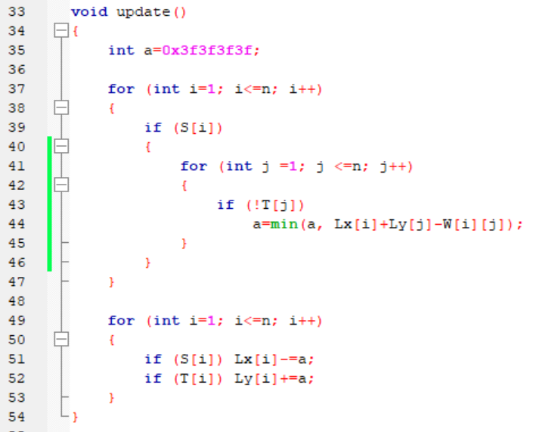
label
label
5
S
Lx
Ly
T
5
1
A
0
3
╳
╳
╳
5
6
4
3
6
0
0
0
0
0
╳
╳
5+0-3=2
-3
6
2
2
B
0
6
6+0-2=4
4
4
3
C
0
-2
3
3
4
D
0
Lef
6
1
2
6
5
E
0
1
X
Y

Slide 76
label
label
5
S
Lx
Ly
T
5-2
1
A
0+2
3
╳
╳
╳
5
6
4
3
6
0
0
0
0
0
╳
╳
5+0-3=2
-3
6-2
2
2
B
0
6
4
4-2
3
C
0
-2
3
3
4
D
0+2
Lef
6
1
2
6
5
E
0
1
X
Y

Slide 77
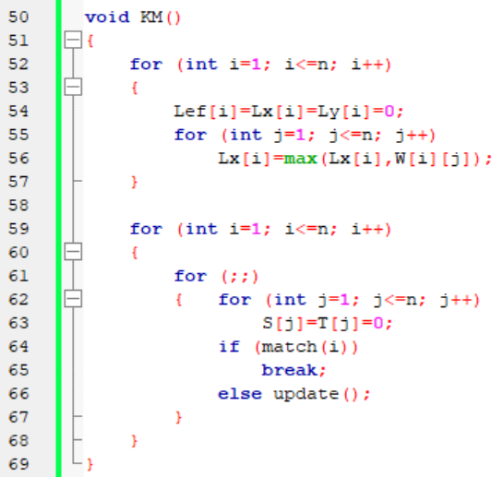

Slide 78
